Slide 1

Are You Creditworthy?
11 June 2024
Group 4
Olivia Yu
Oliver James Uy
Liwei Jiang

Slide 2


AIM
Generate a well-performing prediction model for assessing the eligibility for a credit card.
Using synthetic data, evaluate the determining factors considered by financial institutions when assessing an individual’s creditworthiness.
Explore how to improve the accuracy of chosen classification models that predict whether to approve an individual’s application for a credit card.

Slide 3
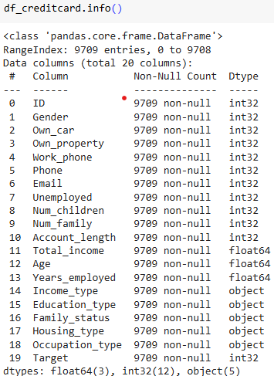




DATA SOURCE
Credit Card Eligibility Data: Determining Factors (https://www.kaggle.com/datasets/rohit265/credit-card-eligibility-data-determining-factors)
Has a wide range of features including demographic, financial, personal attributes
9709 non-null rows
Store data in s3 bucket to retrieve by Spark
Generated dummies for non-numeric fields

Slide 4

METHODOLOGY
General data transformation
train_test_split()
Scale the data
Reduce outlier effects
Models
Random Forest
Neural Network (deep learning)
K_nearest Neighbors

Slide 5
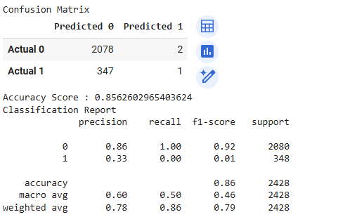
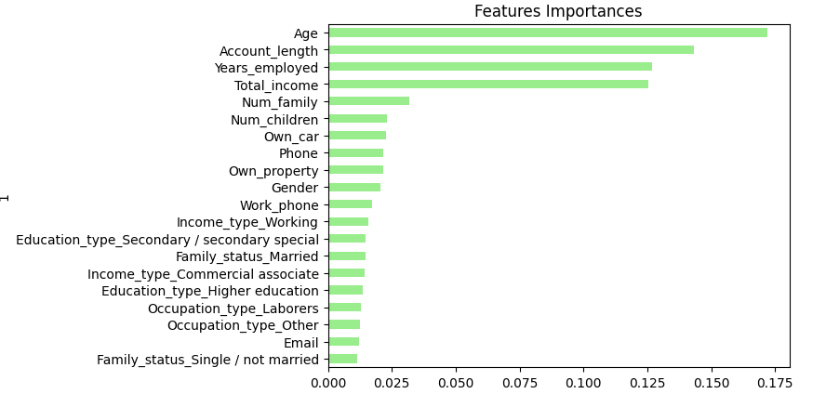
RANDOM FOREST (1)
 | Accuracy | Precision | Recall
RF 1 (n_estimators=500) | 0.8562 | 0: 0.86 1: 0.33 | 0: 1.00 1: 0.00
RF 2 (n_estimators=)
Decided on 20 features that had the highest explainability on the target

Slide 6
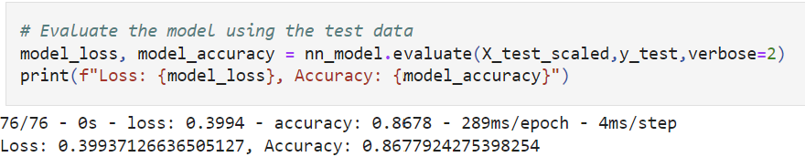
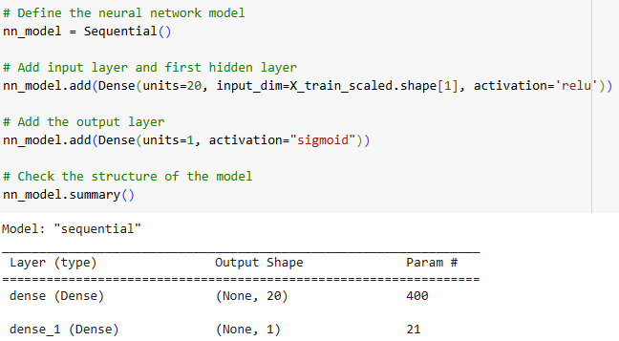
NEURAL NETWORK
Further data cleansing: Winsorize (95%) the data to reduce the effect of outliers
Table: iterative models
 | Hidden layers (HL) | Units | Activation | Epochs | Accuracy
NN1 | 0 | Input: 20 | Input: relu Output: Sigmoid | 50 | 0.8678
NN2 | 1 |  | Input: relu HL1: Output: Sigmoid

Slide 7
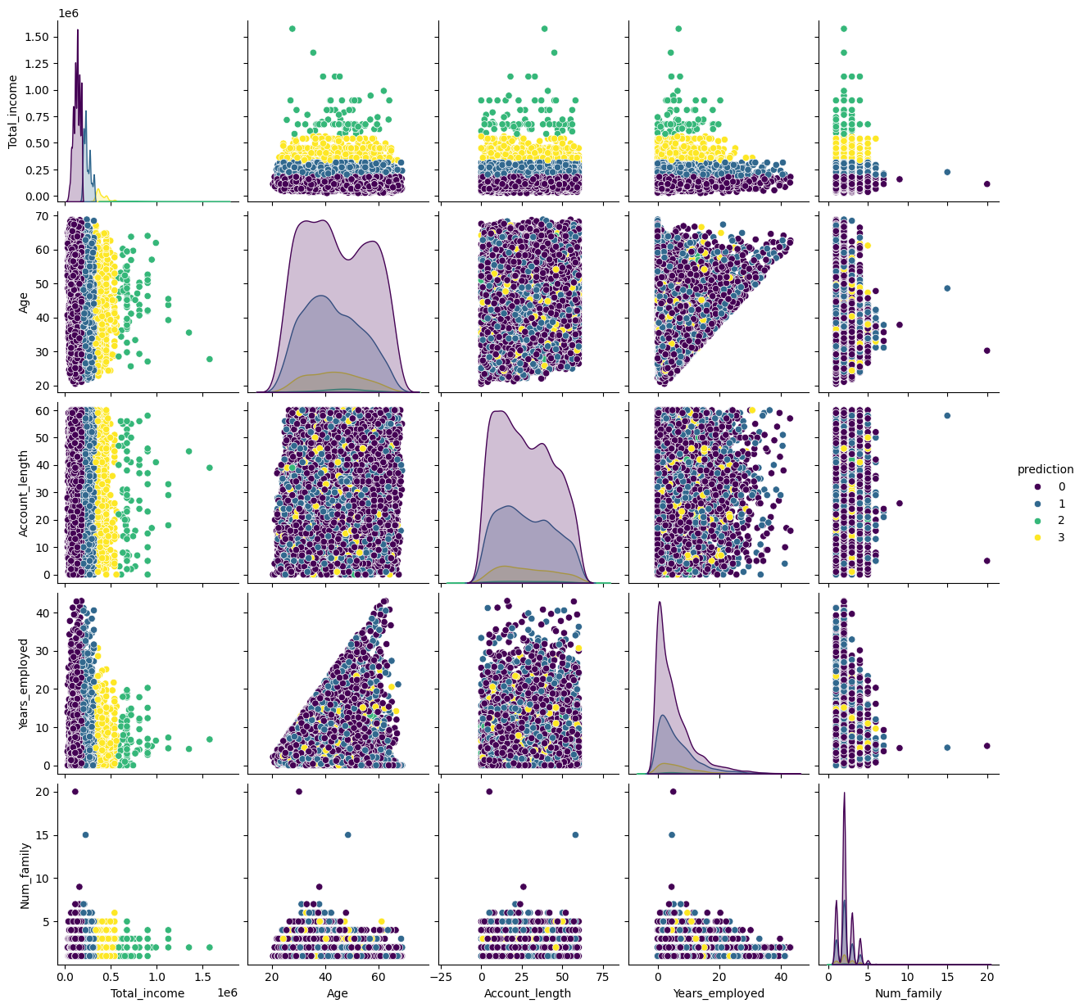
Kmeans Clusters
Notes:
Plotting the Data: This code plots the top 5 features identified and pairs them together. This visualization helps in checking which pairs have clusters that are perfectly separable. This helps identify relationships and patterns in the data.
Key Pairs: Total Income stands out as particularly informative when paired with other features, displaying a clear and noticeable relationship. This validates what is in the actual world where income is a key component of Credit Worthiness.
Analysis: Total Income seems to be the driver in prediction.
Accuracy: The unusually high accuracy score of 1 obtained by the KNN model can be attributed to the synthetic nature of the data. Synthetic data is often clean and properly categorized, making it easier for the model to predict outcomes accurately. While this high accuracy is encouraging, it's important to acknowledge that real-world data may present greater challenges and variability.

Slide 8
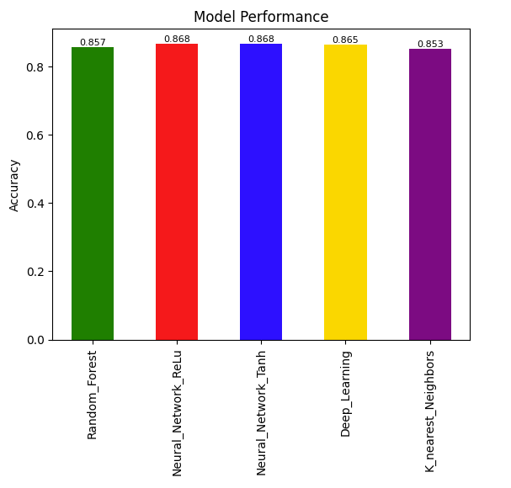
MODEL COMPARISON

Slide 9


LIMITATIONS
Small dataset
Lack of representativeness of larger population
Limited scope and insights derived
Poorer generalisability & transferability
Synthetic data
Does not reflect real-world market data
May miss subtle nuances or potential anomalies in real-world data
Therefore, may not be completely accurate or reliable

Slide 10
FUTURE ENHANCEMENTS
Adopt other machine learning techniques (not covered in the course) to overcome small dataset
Self-supervised learning, semi-supervised learning
Cross validation techniques
Use real-world data
Use a larger dataset

Slide 11
Thank you

